Slide 1

Online Store Data Analysis and Prediction System
Project S1:Arshakyan Maria

Slide 2
Let's go through the code line by line, explaining each part:
The program reads product data from a file, displays information, analyzes statistics, and makes predictions based on the provided dataset. Additionally, it builds a BST to optimize product searches and demonstrates its functionality by searching for a specific product. The project aims to showcase the importance of data analysis and efficient data structures in digital manufacturing solutions.
f

Slide 3
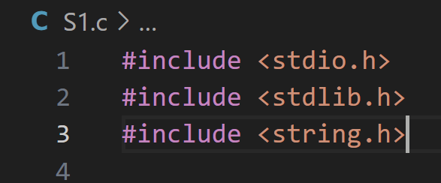
These are include directives to include necessary header files for standard input/output operations, dynamic memory allocation, and string manipulation functions.

Slide 4
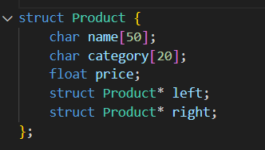
This defines a structure named Product to represent a product. It includes fields for the product name, category, price, and pointers to left and right child nodes in the Binary Search Tree (BST).

Slide 5
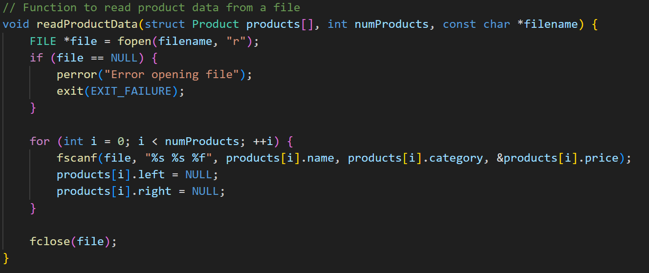
This function reads product data from a file and populates an array of Product structures. It opens the file specified by filename, reads the data using fscanf, and assigns values to the corresponding fields in the Product array. It also initializes the left and right pointers to NULL.

Slide 6

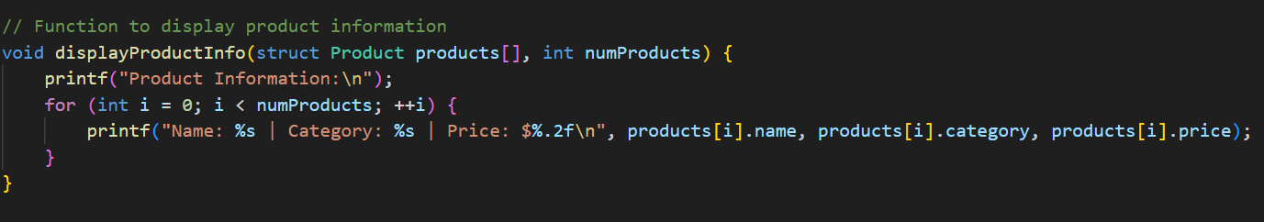
This function prints the information of products in the array to the console.

Slide 7

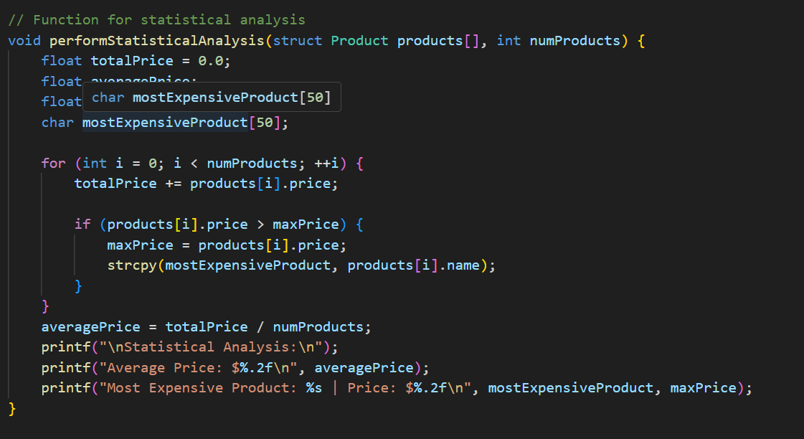
This function calculates statistical information such as average price and the most expensive product from the array of products.

Slide 8
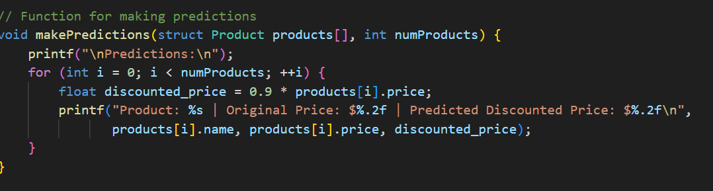
This function makes predictions for each product by suggesting a discount of 10% and printing the original and discounted prices.

Slide 9
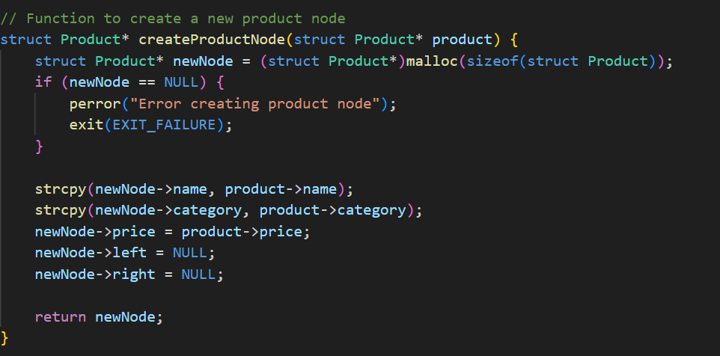
This function dynamically allocates memory for a new product node, copies the values from an existing product, and returns a pointer to the new node.

Slide 10
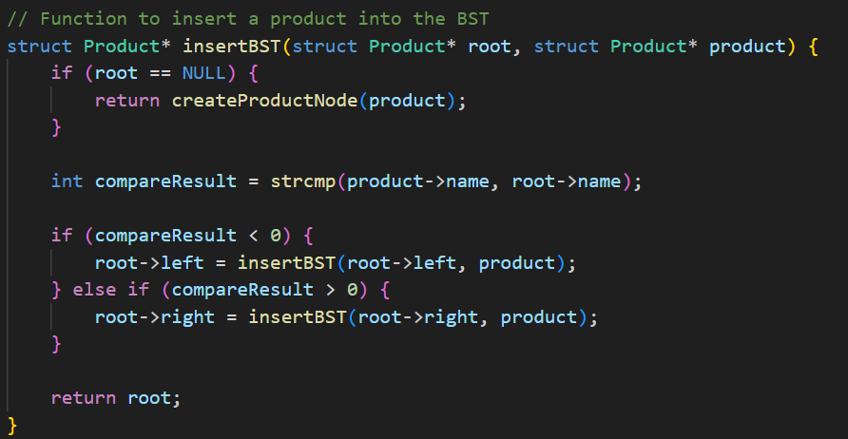
This function inserts a product into a Binary Search Tree (BST). It compares the product name with the root node and recursively inserts the product into the left or right subtree accordingly.

Slide 11
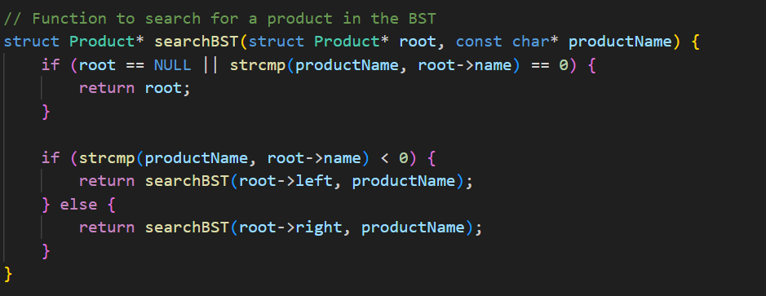
This function searches for a product with a given name in the BST. It returns a pointer to the product if found, otherwise, it returns NULL.

Slide 12
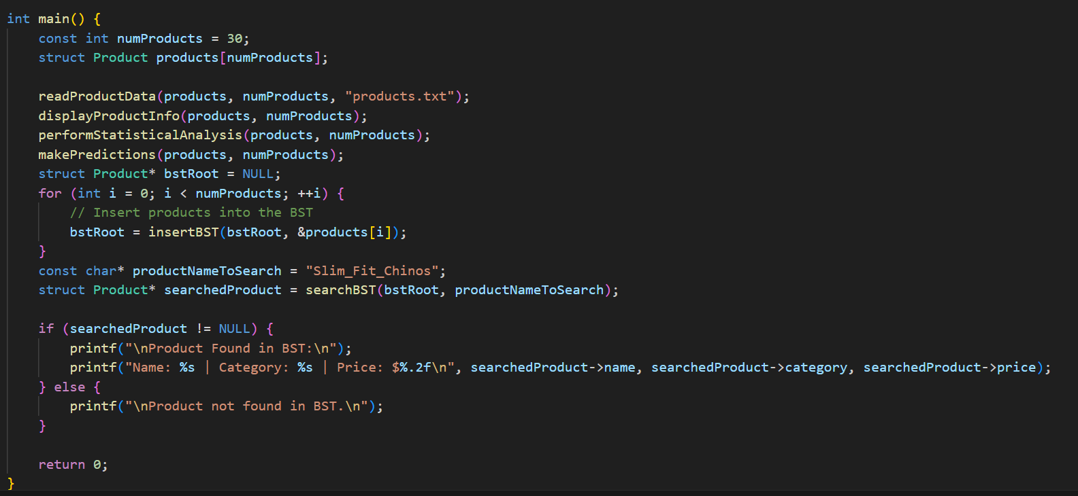
This is the main function. It initializes an array of products, reads product data from a file, displays product information, performs statistical analysis, makes predictions, builds a BST, searches for a product in the BST, and prints the result

Slide 13
